Slide 1
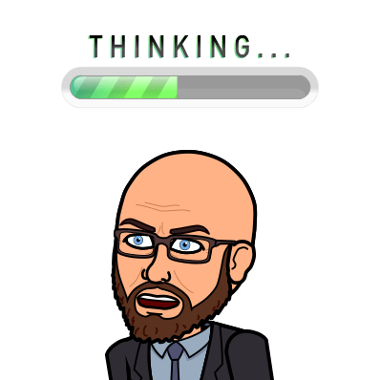
Google Meets Expectations
BE ON TIME
-Pay attention to when the class is live (attendance will be taken)
-Log on a few minutes before class starts
BE IN A QUIET PLACE
-Find the quietest spot you can
-Let others know you’ll not be available until after class
BE PREPARED
-Make sure your computer is charged
-Turn your camera on
-Use headphones if you have them
PRESENTATION
-Wear school appropriate clothing (no underwear or bare skin showing)
-Sit up straight
-Be in camera view
MUTE YOURSELF
-Stay muted while the teacher or another student is speaking
-Please don’t interrupt the speaker.
PARTICIPATION
-Be focused and follow along
-Pay attention (this is NOT the time to be on social media)
-Be actively participating
SIDE NOTE: I WOULD NOT RECOMMEND TRYING TO DO THIS ON YOUR PHONE.
CHAT RESPONSIBLY
-Type your question in the chat box
-Request to unmute in the chat box
-Pay attention to what has already been asked.
COMMUNICATION
-Stay on topic (no side conversations)
-Look up when speaking
-You should NOT be on another device at the same time as the meeting
BE RESPECTFUL
-Be kind
-Be considerate of others and what is expected.

